Slide 1
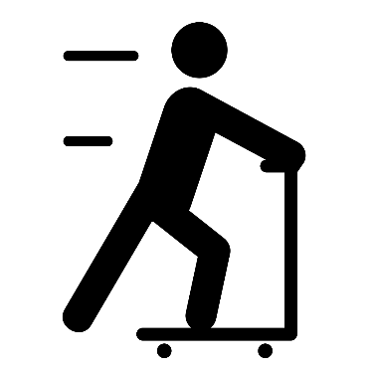
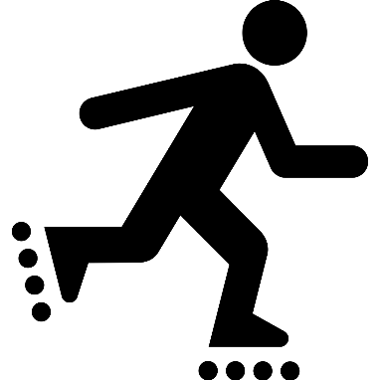
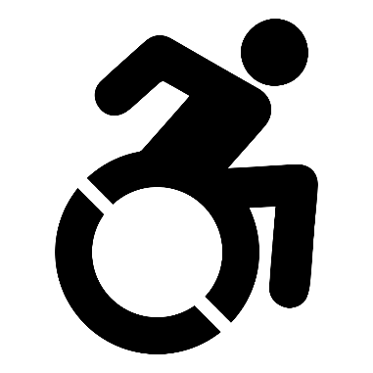
Youth Pedestrian Safety Lessons
DAY 3 – TRAFFIC AND PEDESTRIAN SIGNALS

Slide 2
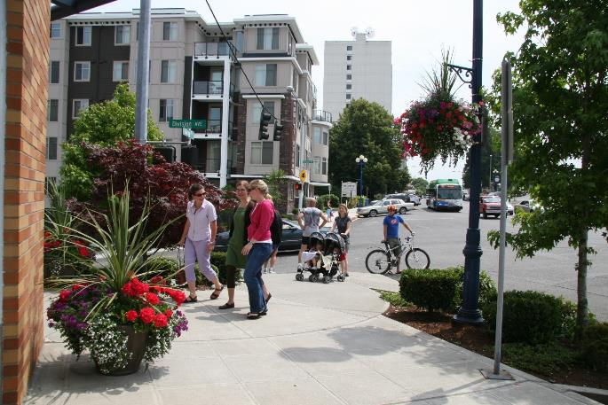
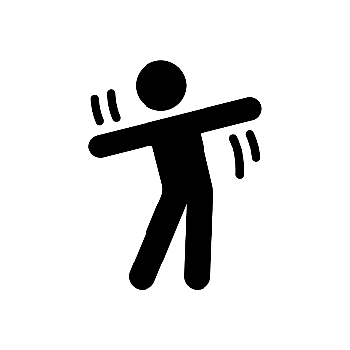
PEDESTRIAN: Someone who walks or moves about using a wheelchair.
ACTION: Walk in place.

Slide 3
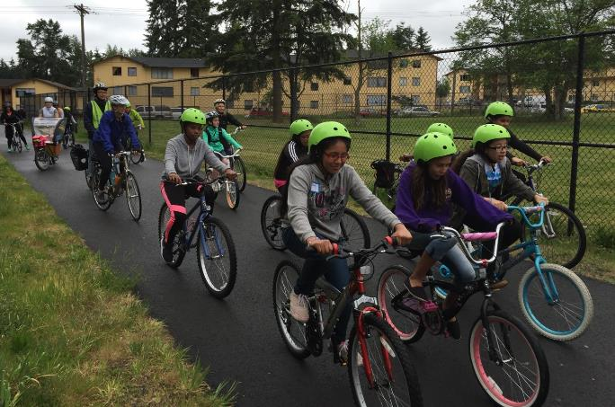
BICYCLIST: Someone who rides a bicycle.
ACTION: Lay on your back and do bicycle crunches OR move your body like you're riding a bike.

Slide 4
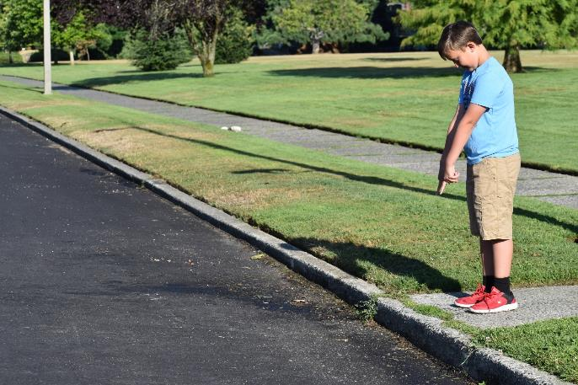
EDGE: A border or outside limit to an area. In this case, where the sidewalk meets the road.
ACTION: Raise your hands above your head, then bend over and point at an imaginary line in front of you. Repeat.

Slide 5
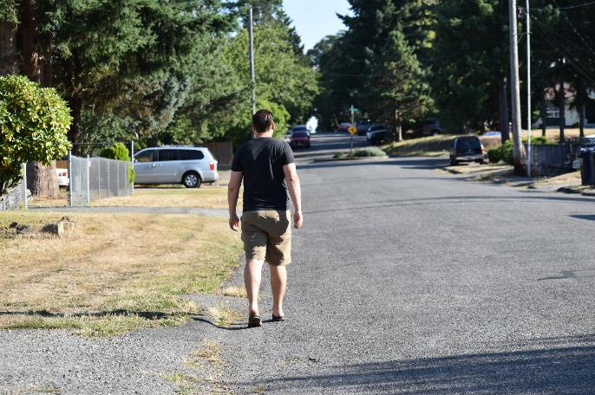
SHOULDER: The edge of the road where cars do not drive. Sometimes a white line separates the shoulder from the road. Cars also sometimes park in the shoulder. The shoulder is used as a sidewalk if there is no sidewalk.
ACTION: Twist your body while brushing each shoulder with the opposite hand.

Slide 6
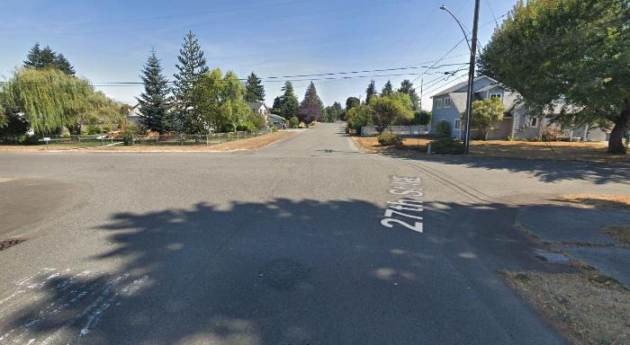
INTERSECTION: A place where two or more streets meet and cross each other.
ACTION: Do five jumping jacks.

Slide 7
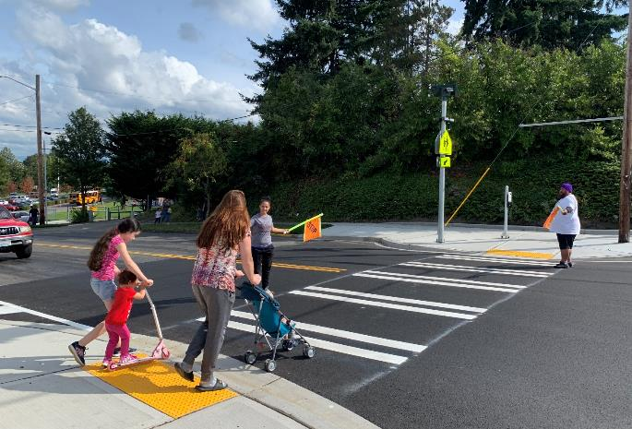
CROSSWALK: Any part of an intersection, either marked with white lines or unmarked, that is for pedestrians to cross the road.
ACTION: Take five steps, then look left-right-left.

Slide 8
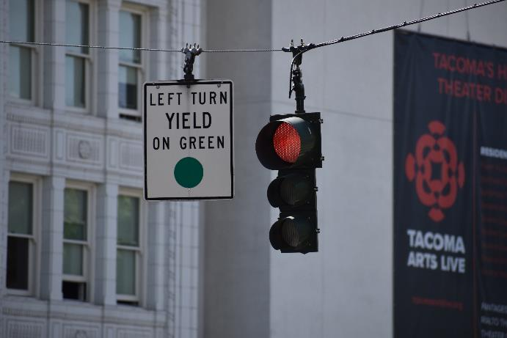
SIGNAL: A gesture, picture, or sound used to give information or instructions.
ACTION: Skip in place.

Slide 9
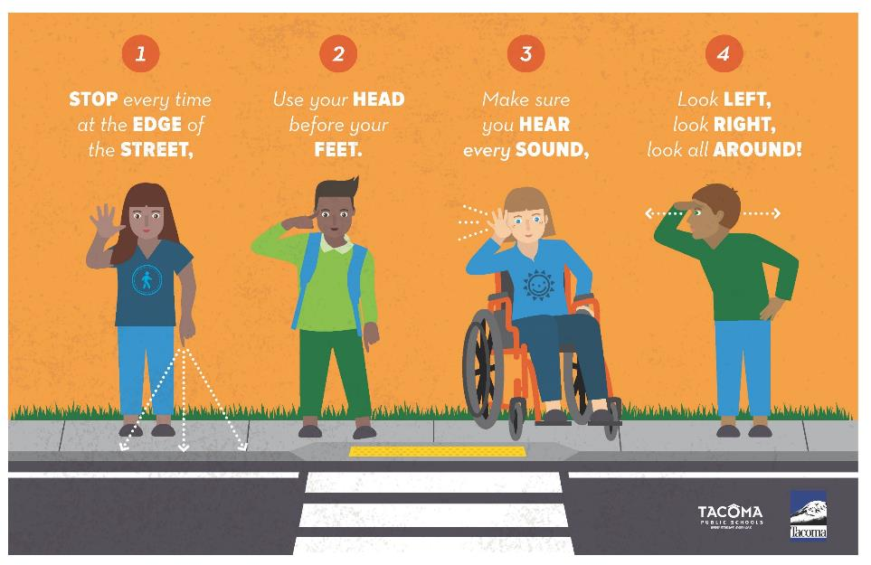

Slide 10
Day 3, Activity 2: Pedestrian Signals

Slide 11
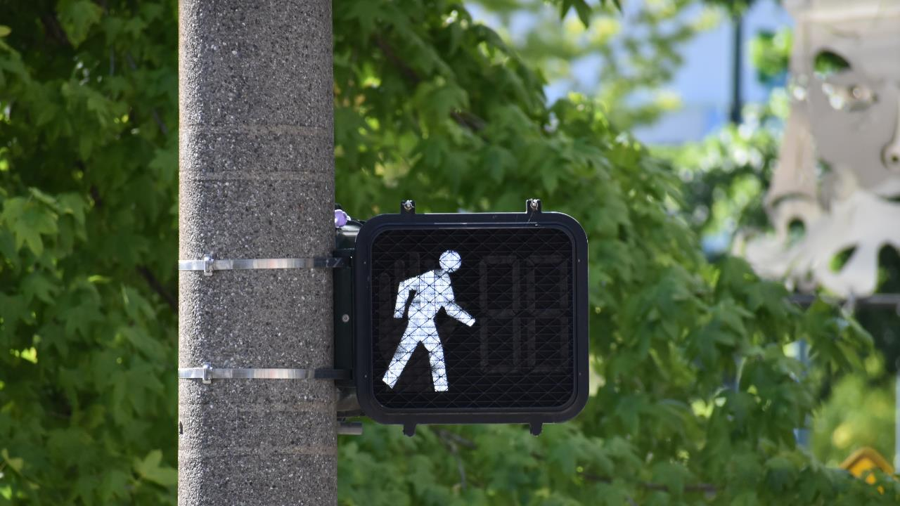
ACTION: Look left-right-left, then start to run in place

Slide 12
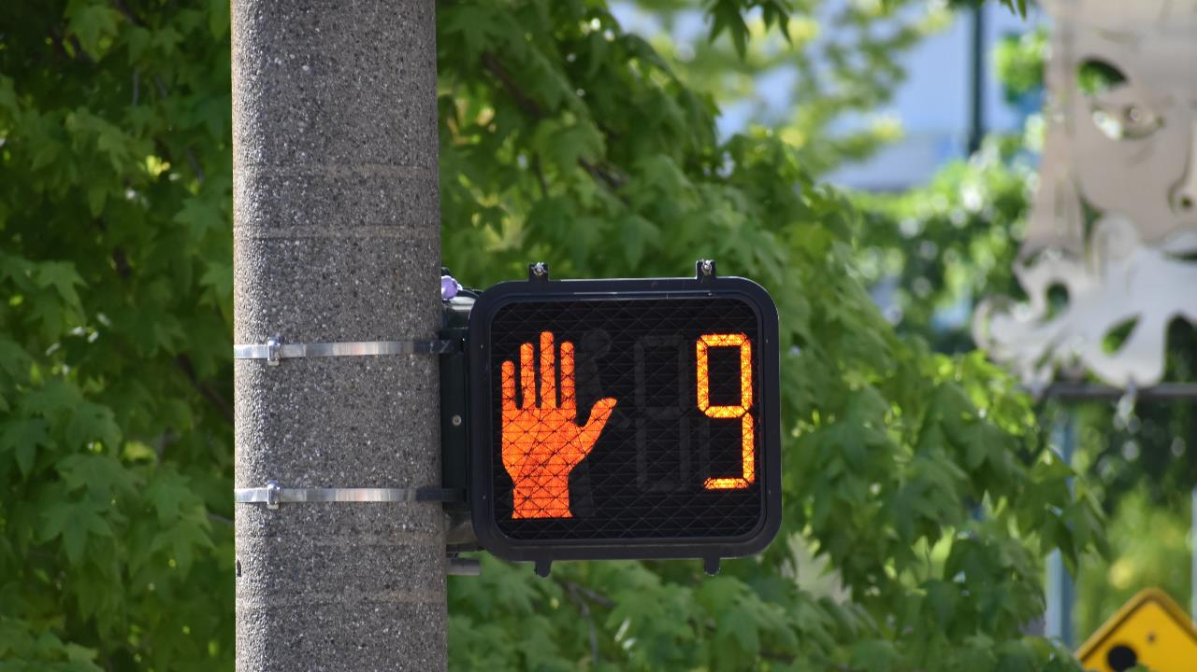
ACTION: Walk in place

Slide 13
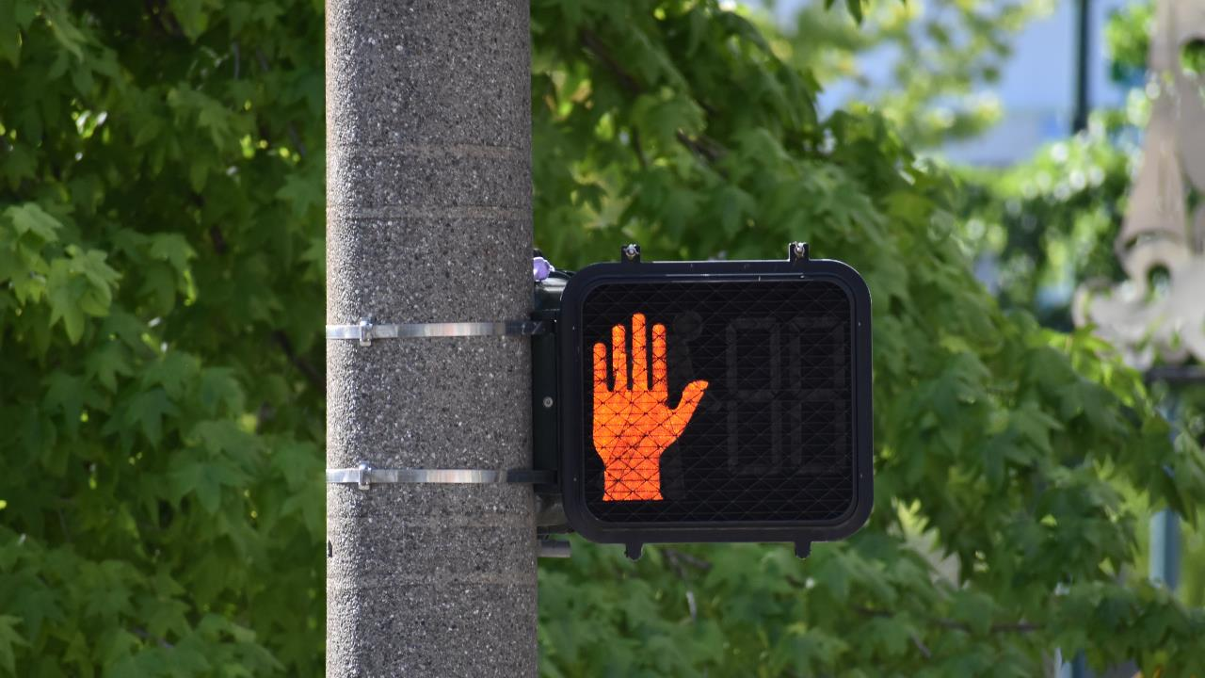
ACTION: Jump up and down and alternate putting your hand out like telling someone to stop

Slide 14
Day 3, Activity 3: Traffic Signals

Slide 15
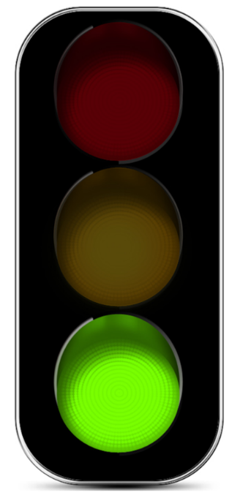
ACTION: Run in place

Slide 16
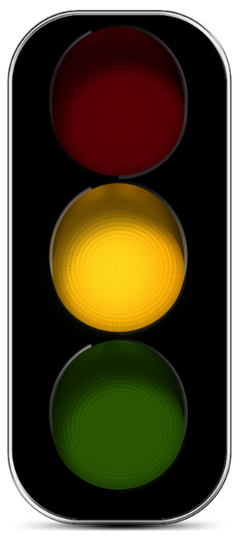
ACTION: Walk in place

Slide 17
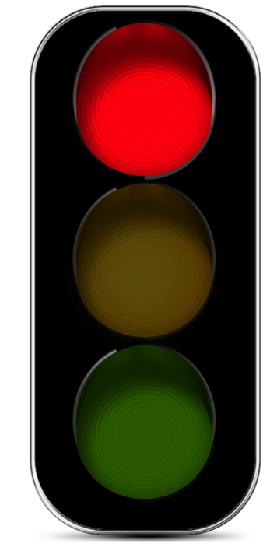
ACTION: Crouch into a sitting position, hold that position

Slide 18
Video: Traffic Signals (3:30 min.): https://tinyurl.com/y242dats

